Slide 1

Final Project Presentation:
Music Recommendation Model
Presented by Team TBD
Members: Konrad Zielinski
Alan Concepcion
Anthony Zhu
Daphne Tang

Slide 2
You’ve listened to music before right?
Finding artists/songs/genres that you really enjoy can be quite a time consuming process. It can be difficult to express what exactly makes you enjoy a piece of music.

Slide 3
Music Recommendation Model
To provide a solution to this problem, we can make a machine learning model which is trained to recognize patterns in different types of music and songs, and then use the model to determine which songs are similar to each other.
We will use the trained model to create a system that allows for a song to be inputted, outputting a list of similar songs, potentially based on a variety of parameters the user can set.

Slide 4
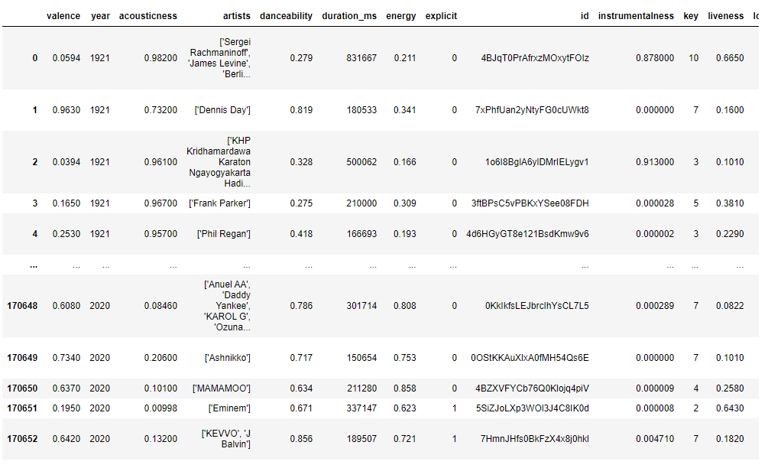
What datasets will we be potentially using?
Music Dataset : 1950 to 2019 posted by Saurabh Shahane
31 Columns
28.4k rows
Spotify dataset posted by Vastal Mavani
5 dataset files total
78 total columns across all files
231k rows across all files
All datasets taken from Kaggle.com!!!
Spotify data example

Slide 5
What will we use to construct the model?
Unsupervised Learning
This form of learning explores patterns in unlabeled data, with no inputs and outputs, only data labels for the model to examine.
Due to the nature of our datasets, we don’t have classes to map outputs nor continuous values to make predictions for, so unsupervised learning is our best method of examining patterns in the data
Clustering Approach (potentially K-means)
K-means is used for clustering and partitioning data. It works by grouping similar data points together into a cluster which we can then use for this project.
How? We will use k-means to group similar songs based on the data in the dataset for example genre, length, and the aesthetic of the sounds which the dataset provides. Our system will take in a user inputted song and using the data provided in the dataset will generate a list of recommended songs

Slide 6
What will we use to construct the model? (cont’d)
Dimensionality Reduction
Easier to analyze and visualize the relationships without sacrificing accuracy
Less dimensions means less computation/training time
Handles multicollinearity (variables that highly correlate with linear relationship)
Required space to store data is reduced
Prevents algorithms from performing poorly due to large dimensions
Dimensionality Reduction Techniques
Missing Value Ratio
Low Variance Filter
High Correlation Filter
Random Forest
Forward Feature Elimination
Factor Analysis
Principal Component Analysis
Methods Based on Projections
T- Distributed Stochastic Neighbor Embedding
Uniform Manifold Approximation and Projection

Slide 7
Spotify API
Spotify Web API allows developers to create applications that can interact with Spotify’s streaming service, such as retrieving content metadata, getting recommendations, creating and managing playlists, or controlling playback.
As an added feature, we will integrate Spotify API in a simple web application to provide users song samples recommended by our model from an input the user provides. This allows users to immediately listen to the song after our model picks the songs, to see if they enjoy it.

Slide 8
Thank you for listening

